Slide 1

ICC / DEFF / CVw Collaboration Stata Demo
Dale Rhoda & Becca Robinson
June 11, 2020

Slide 2
Five Steps to Success
Put the project .ado files in your Stata adopath
Prepare your dataset
Adapt the demo program that calls iccloop
Send output to Biostat Global
Secure permission to publish the data

Slide 3
Step 1 – Project programs in adopath
One method is to copy the project .ado and .sthlp files from the Dropbox folder to your Stata PERSONAL folder
Another method is to save the Dropbox folder on your computer and add the “ADO files” folder to your Stata adopath

Slide 4
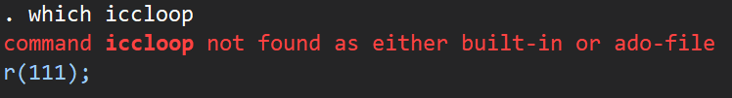
Before iccloop is in your path

Slide 5
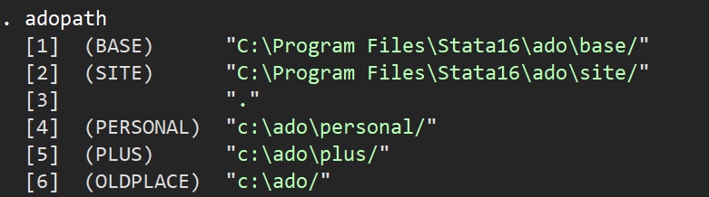
First method: Find your PERSONAL folder
Type the command: adopath
Note the path to the folder beside the word PERSONAL
Mine is c:\ado\personal

Slide 6
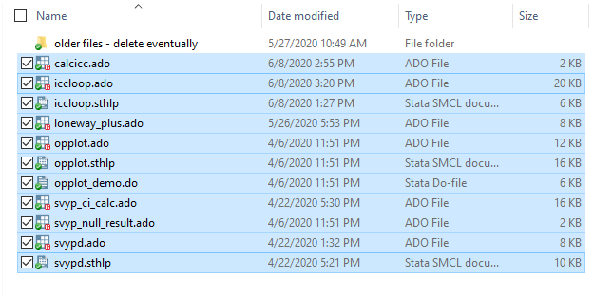
Copy Project .ado files to PERSONAL
Navigate to the Dropbox folder named ‘ADO files’
Select All
Copy
Navigate to your PERSONAL folder
Paste
Now…close Stata and restart it
Type the command: which iccloop

Slide 7
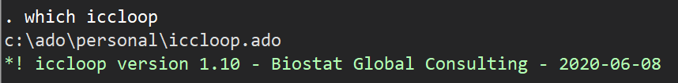
Move Project .ado files to PERSONAL
Stata should find the iccloop.ado program in your PERSONAL folder!
If not…there was a problem with one of the steps above; repeat.

Slide 8
Second Method
If you have saved the Dropbox to your computer, you can simply tell Stata to also look there for .ado files. You do this with the “adopath +” command.
(Of course you modify the path to reflect your folder structure)
And now if we check…Stata can find the program

Slide 9
Step 2. Prepare Your Dataset
You need a minimum of three variables:
Outcome (coded 0/1/ or .)
Cluster ID (integer)
Stratum ID (integer with a value label)
You may name these whatever you like
(Yes, even if there is only one stratum, iccloop needs a stratification variable. You can set it == 1)

Slide 10
Step 2. Prepare Your Dataset
Optional additional variables
Survey weight
Stratum name string variable
You may have a dataset that is already compatible with iccloop, or you may need to do some data management to make it compatible
We will demo that kind of data management today

Slide 11
Step 3. Adapt the Demo .do File
Copy our Harmonia demo .do file and adapt it to call iccloop for your dataset
We will demonstrate this today

Slide 12
Outline of the ICCLOOP Program
For each stratum defined by stratvar
For each outcome in outcome list
Extract survey parameters and put them in a row of the output dataset
End loop
End loop
For a single stratum with 1outcome, iccloop makes 1 row of output
For a single stratum RI survey, with 5 outcomes, it makes 5 lines
For 5 strata and 5 outcomes, a single call to iccloop will make 25 lines of output

Slide 13
Step 4. Bundle the Output and Send It
Please send us:
The dataset(s) with your survey parameters
The organ pipe plots that iccloop makes
The .do file you used to run iccloop
You can send them as e-mail attachments, zipped or unzipped
We can also share a Dropbox folder where you have permission to upload files if that is helpful to you…just ask us

Slide 14
Step 5. Secure Permission to Publish
Please coordinate with the survey Principal Investigator (PI) to get permission to publish the parameters from your survey
Dale is drafting a permission letter template and will circulate it soon
It would be great if someone would translate the letter from English to French
Do we need any other languages for the surveys you have in mind?
I would like to have the permission in writing…a copy of an e-mail or a signed and scanned letter would be terrific…to save for our records

Slide 15
Questions ?
After Q&A, we’ll go to the Stata demo

Slide 16
Demo Dataset
Post-campaign
Only one stratum
The outcome needs to be re-coded
We need to add a stratum ID variable
We will run iccloop twice

